Slide 1


Titolo presentazione sottotitolo
HW2 – Flanger with feedback plugin
10574752 10751438 10612929 10486570
Milano, XX mese 20XX

Slide 2
Index
Flanger with feedback plugin – Introduction
Plugin design - Overview
Parameters choice
Delay
LFO
Implementation in JUCE
Processor
GUI
Demo

Slide 3
Flanger with feedback plugin - Introduction
ASSIGNMENT:
Implement a Flanger effect plugin with feedback.
IMPLEMENTATION:
Design the plug-in in JUCE, coding the audio processor and the Graphical User Interface with Projucer and Visual Studio.

Slide 4
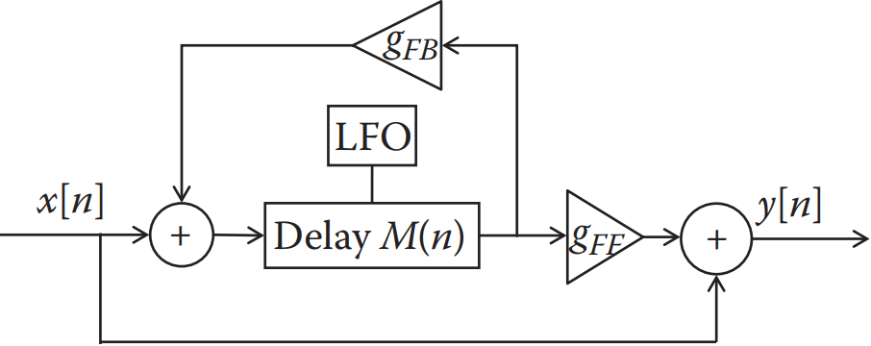

Plugin design - overview
The Flanger is a Delay based plug-in. Its delay time is modulated with a low-frequency oscillator (LFO). Adding a feedback control, the output of the delay line is routed back to its input. We have two gains, $g_{FB}$, which is the feedback gain, and $g_{FF}$, the gain related to the output of the delay line.

Slide 5
Parameters choice - delay
Feedforward (Mix): it represents the amount of delayed signal that is mixed in with the original one. Its values range between 0 and 1.
Feedback: through this parameter it’s possible to control, in practice, how much of the output signal from the delay line we want to send back through the device input. The range of possible values for this plugin is [0; 0:50]. (comb filter)
Delay: it lets the user adjusts the minimum amount of delay of the LFO, in a range of [1:00; 5:00][ms].

Slide 6
Parameters choice - LFO
LFO Width (Sweep Width): it allows the user to control the total amplitude of waveform of the LFO, in a range of [1:00;20:00][ms].
LFO Frequency (Speed): the LFO frequency can be set in a range of [0:05; 2:00][Hz].
Shape of the LFO Envelope: it allows one to select which shape use for the LFO. For this plugin there are three possible waveform shapes: Sine, Triangle and Sawtooth.

Slide 7
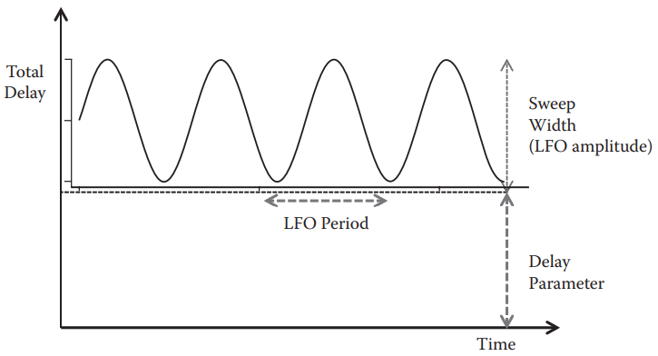

Implementation in JUCE - Processor
Value Tree State
Circular buffers (mod,
maximum length,
delay as difference
of read and write pointers)
Polynomial interpolation
Current delay (echo/chorus perception)

Slide 8
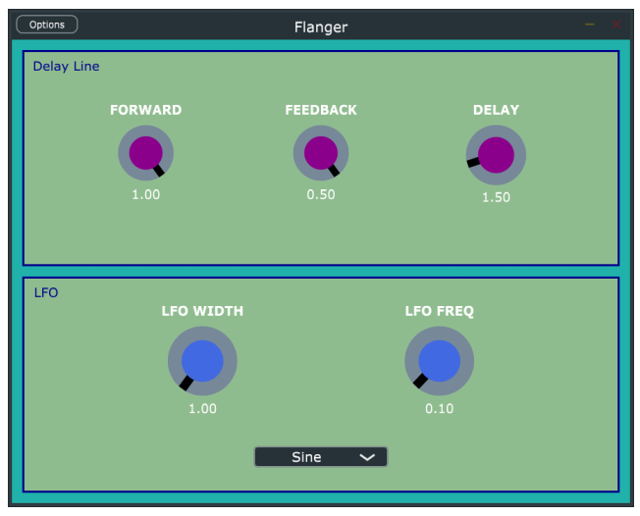
Implementation in JUCE - GUI

Slide 9

Demo
To recreate the famous "jet passing overhead" characteristic sound of the Flanger, we recorded a clean guitar and applied some distortion (adding higher frequencies enhance the effect).
The values we chose for the parameters are the following:
Feedforward = 1
Feedback = 0:25
Delay = 1 ms
LFO Width = 4:5 ms
LFO Freq = 0:1 Hz
Waveform = sine

